Slide 1

Vasireddy Venkatadri Institute of Technology
Elasticity of Demand

Slide 2
Elasticity of demand
The term elasticity is defined as the rate of responsiveness in the demand of a commodity for given change in the price or any other determinants of demand.
According to Marshall “the elasticity of demand in a market is great or small according as the amount demanded increases much or little for a given fall in price.
Elasticity of demand is a quantitative measurement of the change in demand on account of a given change in price or any other determinants.
Then elasticity of demand means the degree of sensitiveness or responsiveness of demand to a change in price, however small or great.
The same is expressed in the form of a small formula,
Price Elasticity (Ep) =

Slide 3
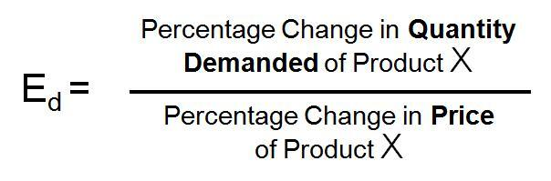
Types of Elasticity of demand
Price Elasticity of demand
Income Elasticity of demand
Cross Elasticity of demand
Advertising Elasticity of demand
1.Price Elasticity of demand:
According to Marshall, Price Elasticity of Demand is the degree of responsiveness of demand to the change in price of that commodity.
Price elasticity is always negative which indicates that the customer tends to buy more with every fall in the price.
The relationship between the price and the demand is inverse. It is measured as follows:

Slide 4
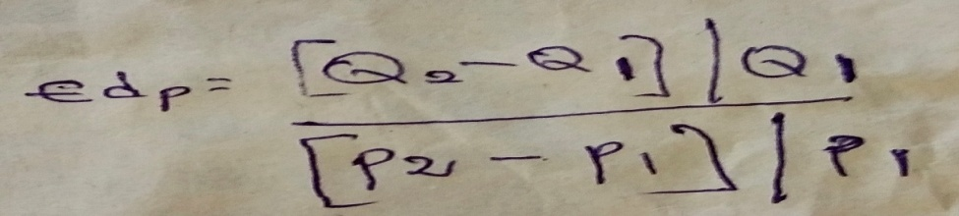

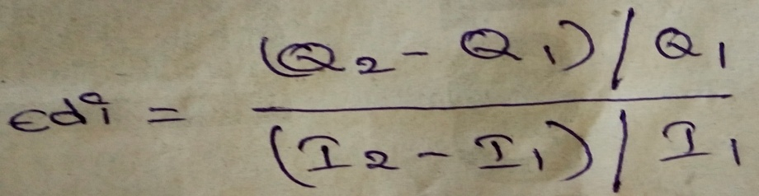
Types of Elasticity of demand
The same is expressed as:
2. Income Elasticity of demand:
Income Elasticity of Demand is the degree of responsiveness of demand to the change in income of the consumer.
Income elasticity is normally positive which indicates that the customer tends to buy more and more with every increase in the income.
The relationship between the income and the demand is direct. It is measured as follows:
the same is expresses as:

Slide 5
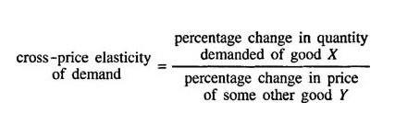
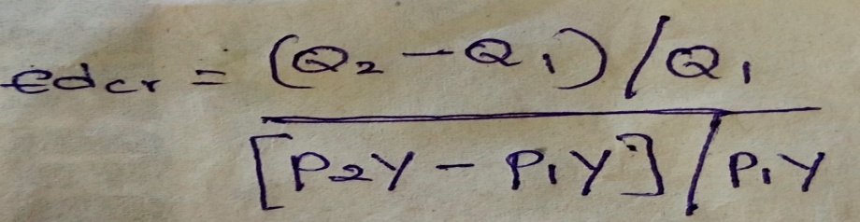
Types of Elasticity of demand
3.Cross Elasticity of demand:
Cross Elasticity of Demand is the degree of responsiveness of demand to the change in price of related commodity, which may be substitute or complement.
cross elasticity is always positive for substitutes (which means that the demand for tea goes up if there increase in the price of coffee).
and negative for complements (which means that if there is an increase in the price of sugar, the demand for coffee tends to fall). It is measured as follows.
The same is expressed as:

Slide 6

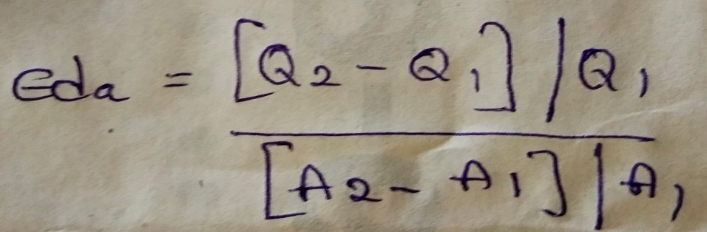
Types of Elasticity of demand
4. Advertising Elasticity of demand:
It refers to increase in the sales revenue because of change in the advertising expenditure.
In other words, there is a direct relationship between the amount of money spent on advertising and its impact on sales.
Advertising elasticity is always positive.
It is measured as follows.
The same is expressed as:

Slide 7
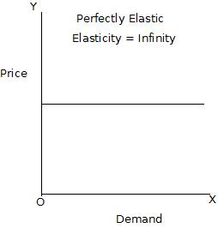
Types of price elasticity of demand:
Perfectly Elastic Demand (E=∞):
Demand is said to be perfectly elastic if negligible change in price would lead to infinite change in the quantity demanded. Visibly, no change in price causes in infinite change in demand.
The shape of demand curve is horizontal.
Ex: Imaginary

Slide 8
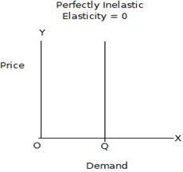
Types of price elasticity of demand:
Perfectly inelastic demand (E=0):
When the demand for a commodity does not change despite change in price, the demand is said to be perfectly inelastic.
The shape of demand curve is vertical. Ex: Salt

Slide 9
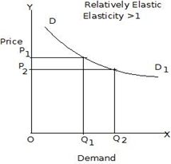
Types of price elasticity of demand:
Relatively Elastic Demand (E>1):
When the percentage change in the quantity demanded for a commodity is more than percentage change in price, it is called relatively elastic demand. For example, if 10% change in price results, 20% change in quantity demanded. The shape of demand curve is more of flat. Ex: Petrol

Slide 10
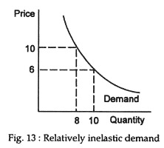
Types of price elasticity of demand:
Relatively Inelastic Demand (E<1):
When the percentage change in the quantity demanded of a commodity is less than percentage change in the price, it is called relatively inelastic demand. For example, when 20% change in price causes 10% change in demand.
The shape of demand curve is more of steep. Ex: Sugar

Slide 11
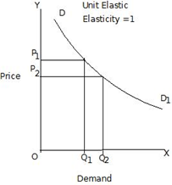
Types of price elasticity of demand:
Unitary Elastic Demand (E=1):
When the percentage change in the quantity demanded is equal to the percentage change in price, the demand for a commodity is said to be unitary elastic demand.
For example, 10% change in price causes 10% change in demand. The shape of demand curve is rectangular hyperbola. Ex: Cloths

Slide 12
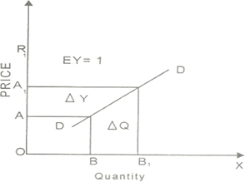
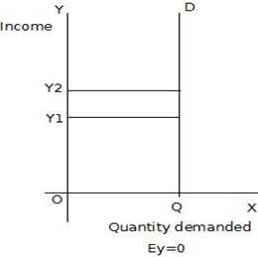
Types of Income Elasticity of Demand:
There are five types of income elasticity of demand as follows:
Zero income elasticity (Ey=0): Ex: Necessaries (Food)
If the rise in income, the quantity demanded remains unchanged, the income elasticity is called zero income elasticity.
Income elasticity equal to unity (Ey=1):
Income elasticity is unity when the demand for a commodity increases in the same proportion as the rise in income. Ex: Cloths

Slide 13
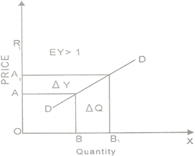
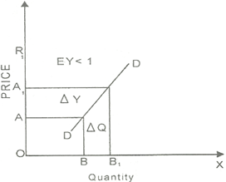
Types of Income Elasticity of Demand:
Income elasticity greater than unity (Ey>1):
The income elasticity of demand is greater than the unity when the demand for a commodity increases more than percentage rise in income.
Ex: Consumer Durables (AC, TV, Washing Machine Etc.)
Income elasticity less than unity (Ey<1):
Income elasticity of demand is less than the unity when the demand for a commodity increases less than proportionate to the rise in income. Ex: Sugar

Slide 14
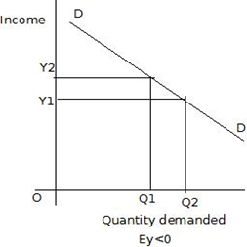
Types of Income Elasticity of Demand:
Negative income elasticity (Ey<0):
In the case of inferior goods, the income elasticity of demand is negative. The consumer will reduce his purchase of it when income rises and vice versa. Ex: Inferior Goods

Slide 15
Factor determining the elasticity of demand
Nature of goods:
Elasticity of demand depends on the nature of goods.
The elasticity of demand for a commodity depends upon the necessity of it for a human life.
Goods may be necessary for human life, comfort or luxurious.
Necessary goods are extremely essential so the demand for these goods-is inelastic.
But the consumption of comfort and luxury goods enhances man's efficiency and social prestige.
So their consumption is less important and can be very well postponed.
Thus the elasticity of demand for such commodities is elastic.

Slide 16
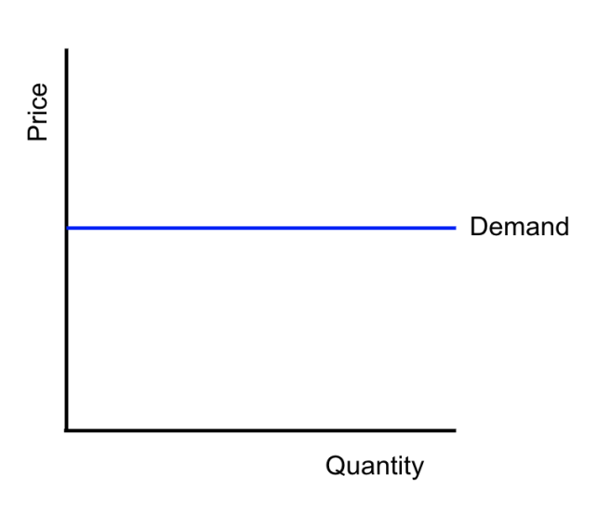
Factor determining the elasticity of demand
Possibility of postponing consumption:
The demand for those goods whose consumption can be postponed for some time is said to be elastic.
On the other hand if the commodities cannot be postponed and need to be fulfilled the demand for them is inelastic.
Medicine for a patient, books for a student and milk for a child cannot be postponed. They are to be satisfied first. That is why the demand for those commodities is inelastic.

Slide 17
Factor determining the elasticity of demand
Alternative use:
The demand for those goods having only one use is said to be inelastic.
In other words goods having alternative uses are elastic.
For example electricity can be used for a number of purposes like heating, lighting, cooking, cooling etc.
Availability of substitutes:
The demand for a commodity having perfect substitute is relatively more elastic, because if there is an increase in the price of commodity, people will start using other commodities.
Ex: Gas, kerosene, electricity, coal and wood are used as fuel. The increase in the price of one commodity will induce the consumer to use other commodity.
The demand for a commodity having no substitute is will be inelastic such as salt. Any increase or decrease in the price of salt will not affect its demand.

Slide 18
Factor determining the elasticity of demand
Proportion of income spent:
Elasticity of demand also depends on the proportion of income spent on different goods.
The demand for those goods on which a negligible amount (small part of income) of the total income of the consumer is spent is said to be inelastic.
Ex: needle, thread, ink, button etc.
The demand for those goods on which a significant amount of the total income of the consumer is spent is said to be more elastic. Ex: woollen suits, luxuries etc.
Time period:
The demand for a commodity is based on time period.
The demand is elastic in the long period and inelastic in the short period because in the short period, generally demand does not change immediately due to price changes. However, it is true in the long period.

Slide 19
Factor determining the elasticity of demand
Change in income:
The demand for various goods are affected in different degrees due to change in income.
In case of increase in the income of consumers, the demand for luxuries will increase.
If the income falls, the demand for luxuries will fall. As such demand for luxuries is more elastic in relation to change in income,
In case of comforts it is less elastic and in case of necessaries it is probably inelastic.
Force of habit:
A repeated and constant use of a commodity by a person forms habit. A habit can't be avoided. Thus in such a case the consumption of the commodity can't be abstained in spite of the rise in price.
The consumer has to satisfy his habit regardless of change in price. Thus the demand for habitual commodities is fairly inelastic.

Slide 20
Factor determining the elasticity of demand
Income level (Distribution of income):
Elasticity of demand depends on income level.
The rich and the poor are not equally affected at the change in price.
Poor people are more affected than the rich. Because of high income rich people buy the same amount of an expensive commodity in response to a rise in price.
For example with a rise in price of Horlicks, poor people buy other milk powder relatively cheaper than Horlicks. Thus for rich people the demand for Horlicks is inelastic whereas for poor people the demand for the Horlicks is elastic.
Joint demand:
The demand for jointly demanded goods is less elastic. Ex: petrol and car. Similarly the demand for salt is inelastic because consumers do not use it alone.

Slide 21
Factor determining the elasticity of demand
Price-level:
If the price is either too high or too low, the demand will be less elastic or inelastic.
When the prices are moderate, elasticity will be greater.

Slide 22
Methods of measuring elasticity of demand
Methods of measuring elasticity of demand:
Percentage (or) Proportionate method
Total outlay (or) Expenditure method
Geometric method (or) Point method
Arc method

Slide 23
Methods of measuring elasticity of demand
Percentage or proportionate method:
In this the elasticity of demand is measured by the percentage or proportionate change in demand due to change in price.
Formula:-
Elasticity of demand (% method) = % change in demand/% change in price.
Elasticity of demand (proportionate method) = proportionate change in demand/proportionate change in price.
If Ed>1, demand is elastic
If Ed<1, demand is inelastic
If Ed=1, demand is unity elastic.

Slide 24
Methods of measuring elasticity of demand
Total outlay (expenditure) method:
Marshall evolved the total outlay, total revenue or total expenditure method as a measure of elasticity.
By comparing the total expenditure of a purchaser both before and after the change in the price.
Total outlay is price multiplied by the quantity of a commodity purchased.
Formula To = TQ×P
Where TO is total outlay
TQ is total quantity
P is price of the commodity
Q is quantity of the commodity.

Slide 25
Methods of measuring elasticity of demand
S.No | Price (in Rs) | Demand | Total out lay (in Rs) | Elasticity
1 | 1.50 | 2 | 3.00 | N=1
2 | 1.00 | 3 | 3.00
3 | 0.80 | 4 | 3.20 | N>1
4 | 0.70 | 5 | 3.50
5 | 0.50 | 6 | 3.00 | N<1
6 | 0.40 | 7 | 2.80
This method provides three types of results:
Unitary elasticity (E=1): if small change in price, total outlay is unaffected then elasticity of demand is unity.
Elastic demand (E>1): if small reductions in price, increases total outlay (or) if small increase in price reduces total outlay, then demand is elastic.
Inelastic demand (E<1): if small reductions in price, leads to a fall in total outlay (or) if small increase in price, increases total outlay, and then demand is inelastic.

Slide 26
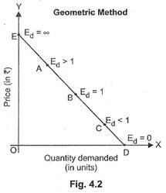
Methods of measuring elasticity of demand
Geometric or point method:
Graphic method is otherwise known as point method or Geometric method. This method was popularized method.
According to this method elasticity of demand is measured on different points on a straight line demand curve.
The price elasticity of demand at a point on a straight line is equal to the lower segment of the demand curve divided by upper segment of the demand curve.
Thus at midpoint on a straight-line demand curve, elasticity will be equal to unity; at higher points on the same demand curve, but to the left of the mid-point, elasticity will be greater than unity, at lower points on the demand curve, but to the right of the mid­point, elasticity will be less than unity.

Slide 27
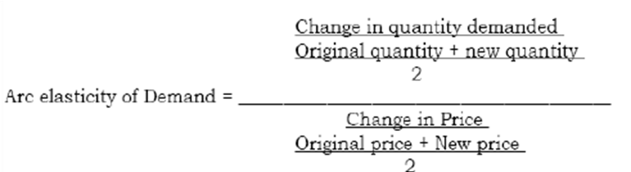
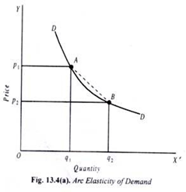
Methods of measuring elasticity of demand
Arc method:
Since point method gives different results for the same change in price, economists have devised Arc method for measurement of elasticity between two points on the same demand curve.
So elasticity of demand is measured in between two points at two price levels on the same demand curve or line, it is known as Arc elasticity.
Note: if there is no difference between the two point and they merge into each other, Arc elasticity becomes point elasticity.

Slide 28
Significance of elasticity of demand:
Concept of elasticity of demand is very useful to the producers and policy makers alike.
It is very valuable tool to decide the extent of increase or decrease in price for a desired change in the quantity demanded for the products or services in the firm or the economy.
The following are its applications:
To fix the prices of factors of production (land, labour, capital, org and technology).
To fix the prices of goods and services provided rendered.
To formulate and revise government policies.
Tax policies
Raising bank deposits
Public utilities
Revaluation and devaluation of currencies
Formulate government policies.
Demand forecasting
To planning the levels of output and price.

Slide 29



